Slide 1
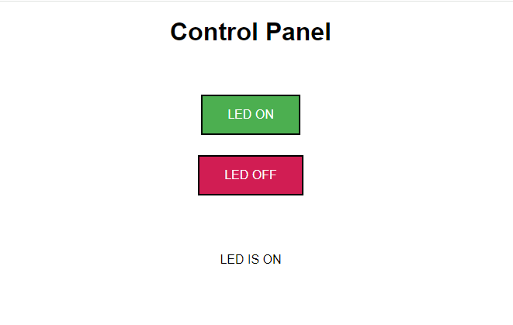
This is what we did last meeting
picowebserver.py
wificonfig.py
index.html

Slide 2
<!DOCTYPE html><html>
<head><meta name="viewport" content="width=device-width, initial-scale=1">
<link rel="icon" href="data:,">
<style>html { font-family: Helvetica; display: inline-block; margin: 0px auto; text-align: center;}
.buttonGreen { background-color: #4CAF50; border: 2px solid #000000;; color: white; padding: 15px 32px; text-align: center; text-decoration: none; display: inline-block; font-size: 16px; margin: 4px 2px; cursor: pointer; }
.buttonRed { background-color: #D11D53; border: 2px solid #000000;; color: white; padding: 15px 32px; text-align: center; text-decoration: none; display: inline-block; font-size: 16px; margin: 4px 2px; cursor: pointer; }
text-decoration: none; font-size: 30px; margin: 2px; cursor: pointer;}
</style></head>
<body><center><h1>Control Panel</h1></center><br><br>
<form><center>
<center> <button class="buttonGreen" name="led" value="on" type="submit">LED ON</button>
<br><br>
<center> <button class="buttonRed" name="led" value="off" type="submit">LED OFF</button>
</form>
<br><br>
<br><br>
<p>%s<p>
</body></html>

Slide 3
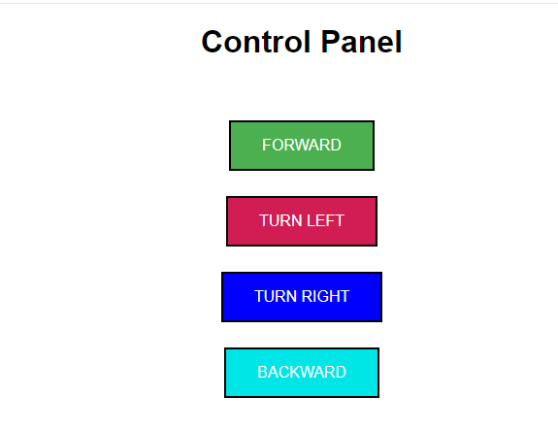
To control the robotic car
We need an interface like this

Slide 4
On screen demo to show how to convert

Slide 5
#1 - Open index.html in Thonny
Save it has robot.html
#6 – Modify robby.py
#7 – Transfer robot functionality
from robotic_car_test.py to robby.py
#2 - Open picowebserver.py
Save it has robby.py
#8 – interface http request with robot
functionality
#9 – Test
#3 – Edit robot.html
#4 – Rename index.html in robby.py
To robot.html
#5 – Test run and check out
The new interface robot.html

Slide 6
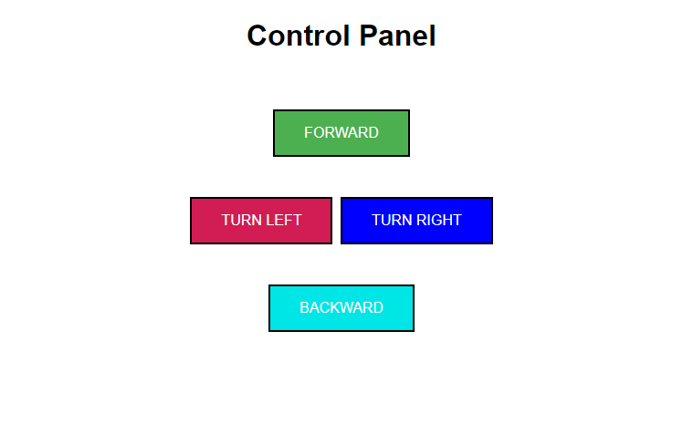
And how to get ChatGPT to convert it to this
beautiful interface. ☺

Slide 7
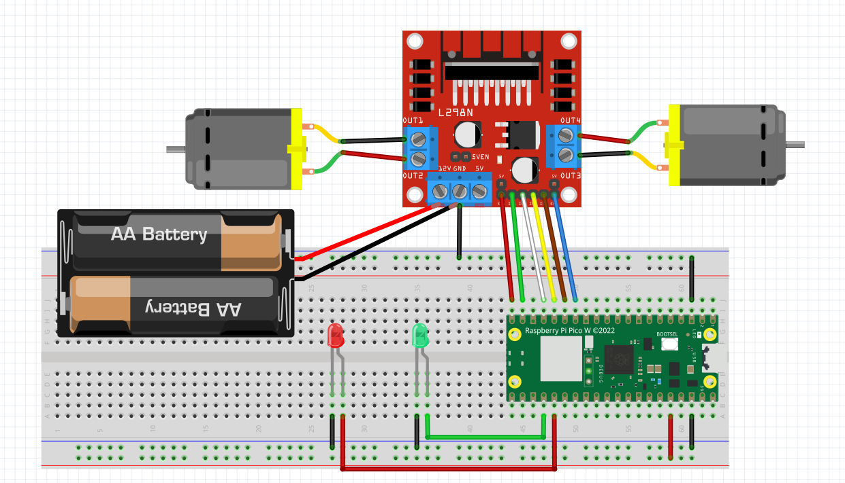
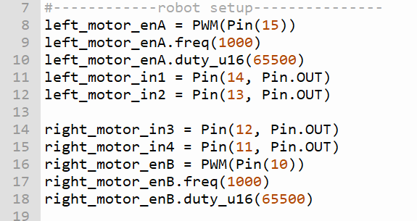
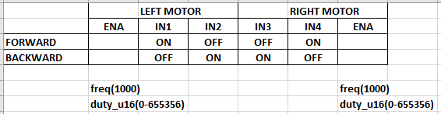
WIRING DIAGRAM OF TEST ROBOT
ROBOT ORIENTATION
LEFT MOTOR
RIGHT MOTOR
Follow the wire colour in this diagram
15 14 13 12 11 10
ENB

Slide 8
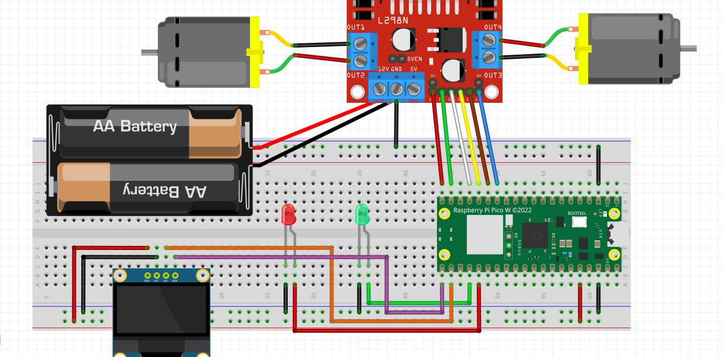
Vcc Gnd SCL SDA
SCL – Pin 17
SDA – Pin 16

Slide 9
FORWARD
LEFT
STOP
RIGHT
BACKWARD

